Slide 1

Theory Of Relativity

Slide 2


Slide 3

CONTENTS

Slide 4

SPECIAL THEORY OF RELATIVITY

Slide 5
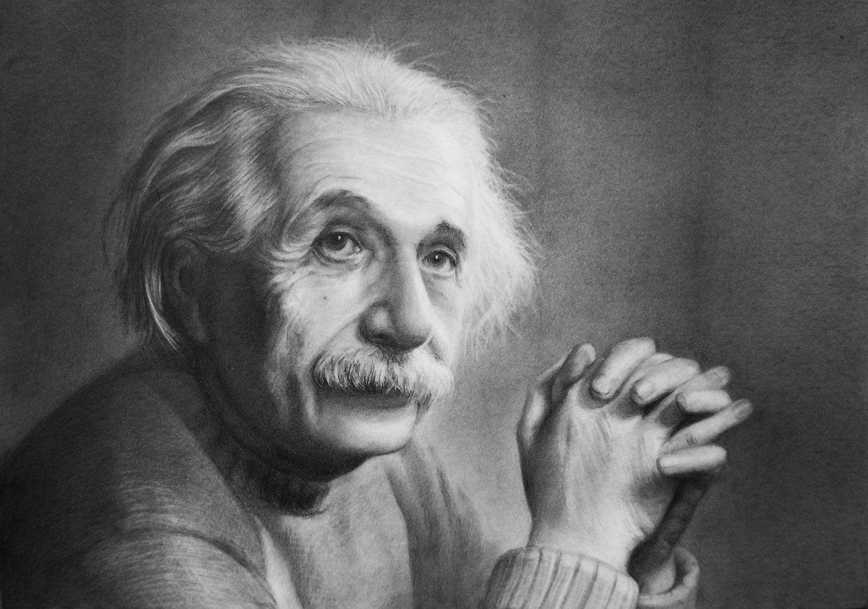
THE THOUGHT EXPERIMENT

Slide 6

REVOLUTIONARY CHANGES

Slide 7

THE GENERAL TEORY OF RELATIVITY

Slide 8
